Slide 1

Intersection of Pandemic and Progress
Deciphering the Impact of COVID-19 on World Development
Uthkarsh Reddy Junuthula
CSCE 5320
SCIENTIFIC DATA VISUALIZATION

Slide 2
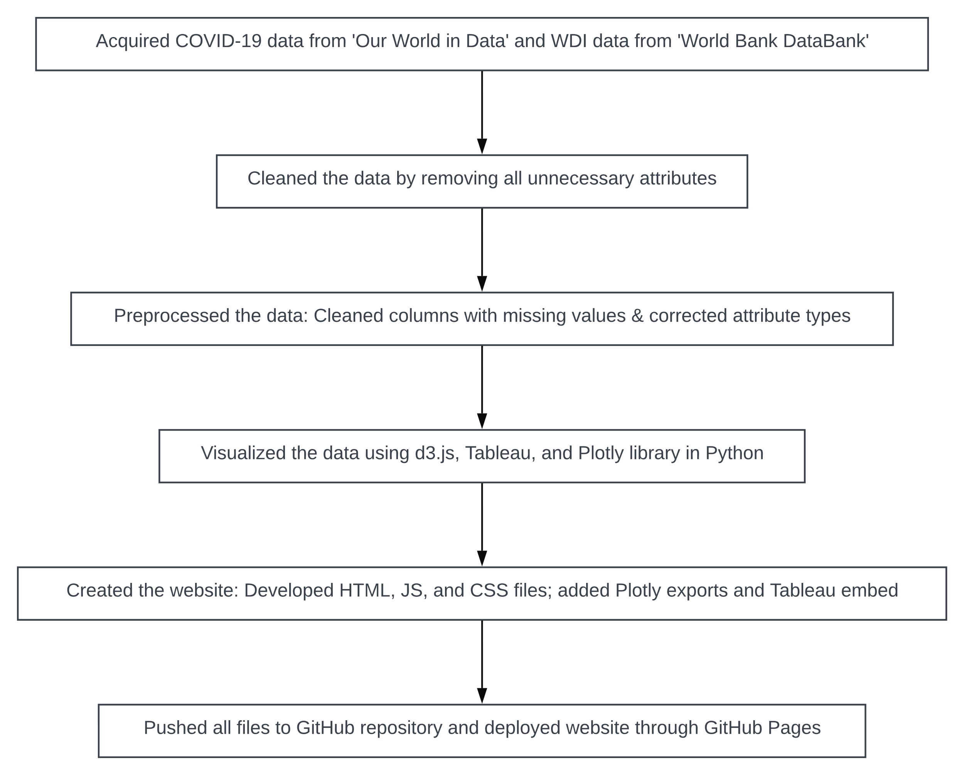
Introduction – Domain and Workflow
Domain: Global Health and Economic Development
Through this project, my aim was to explore the he complexities of the global socio-economic and demographic insights, with a particular focus on the impact of the recent COVID-19 pandemic on these areas and the changes to these sectors after the pandemic.
I have accomplished this by visualizing the relationship between the selected datasets to represent and understand the pandemic's effects on different countries' economies, health systems, environmental sustainability, educational achievements, and social progress
The end goal was to gain a better understanding of the pandemic's global influence and to show the relationship between health crises and global development trends.

Slide 3
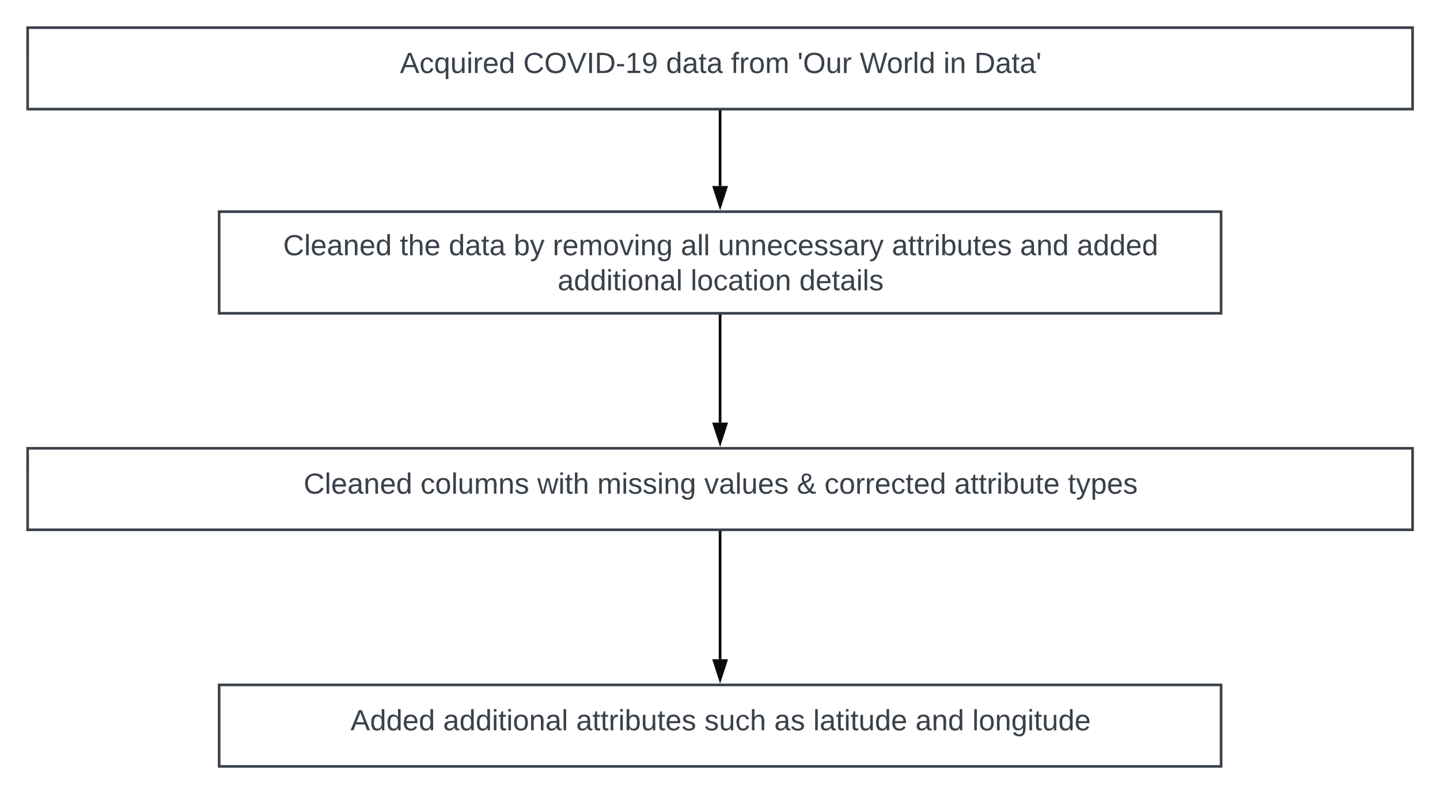

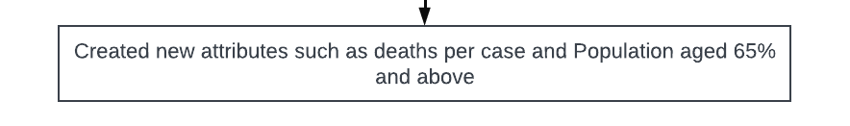
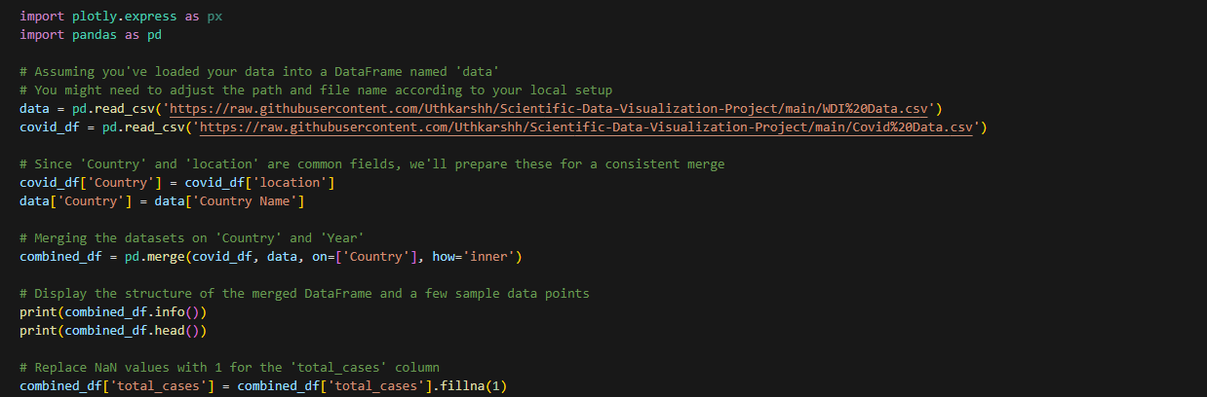
Data Abstraction (1)
Covid 19 Dataset
Dataset Type and Attributes:
Type: Time-series data
Overview: The COVID-19 dataset is a comprehensive collection of data points tracking the spread and impact of the COVID-19 pandemic globally. This dataset is structured as a time-series, with daily records for various health, social, and economic indicators related to the pandemic.
Attributes: This dataset contains 33 attributes including iso_code, location, latitude, longitude, date, total_cases, new_cases, new_deaths, and various metrics related to vaccinations, testing, and economic indicator such as gdp_per_capita stringency_index,population_density,median_age,aged_65_older,aged_70_older,gdp_per_capita,extreme_poverty.
Number of Records: 373,687 entries
Data Transformation: I have cleaned the dataset by deleted unnecessary columns and changed the data types of variables to appropriate data types. I have also added the latitude and longitude variables.

Slide 4
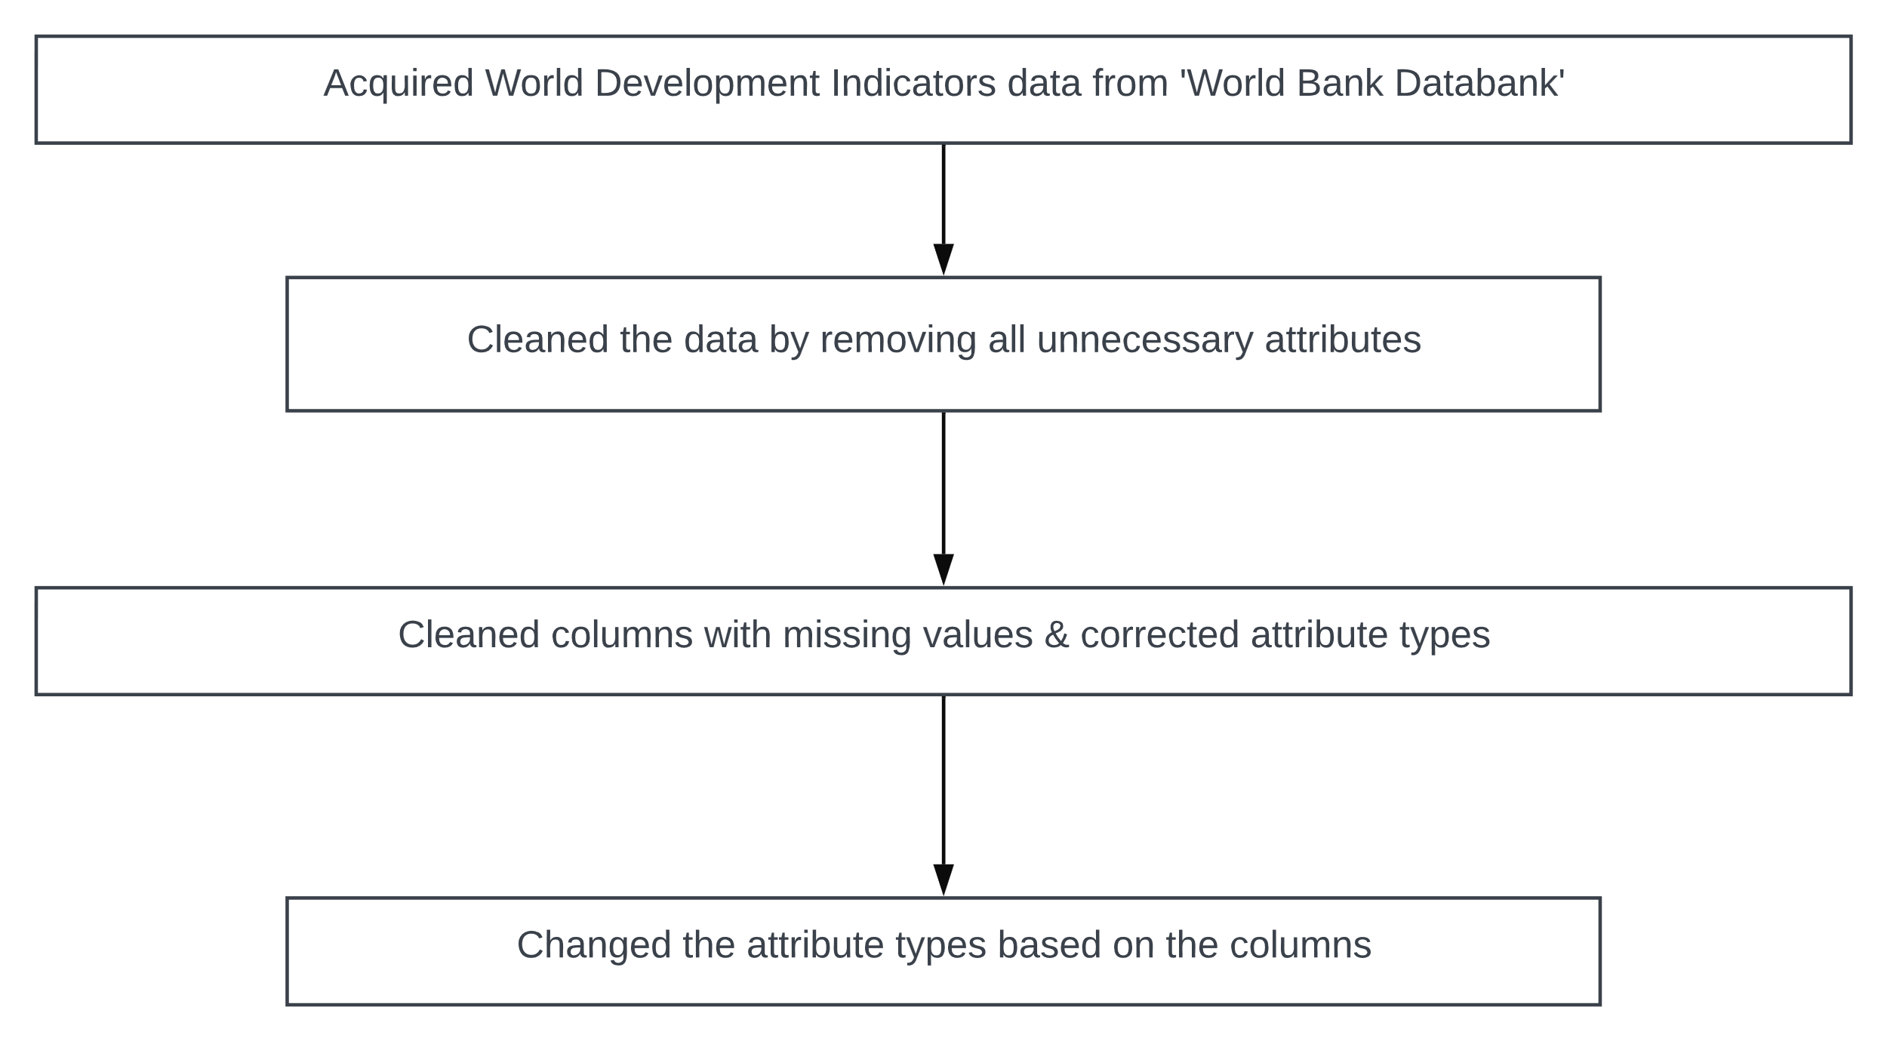
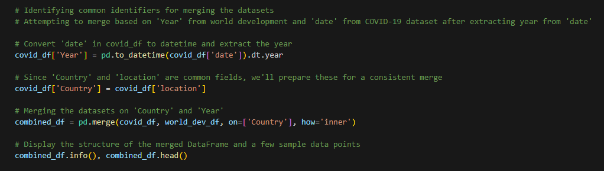
Data Abstraction (2)
World Development Indicators (WDI) Dataset
Dataset Type and Attributes:
Type: Cross-sectional data combined with time-series
Overview: The World Development Indicators dataset is a rich and comprehensive dataset provided by the World Bank, featuring a wide range of economic, social, and environmental indicators from countries around the world. This dataset is primarily used for global development research and consists of both cross-sectional data and time-series data.
Attributes: The dataset includes 57 attributes covering various development indicators such as Population, total, GDP (current US$), Internet users (per 100 people), and Health expenditure, total (% of GDP) among others.
Number of Records: 43,157 entries
Data Transformation: Similar to the Covid 19 dataset, I have cleaned the dataset by deleted unnecessary columns and changed the data types of variables to appropriate data types.

Slide 5
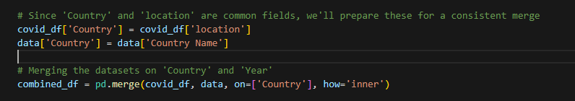
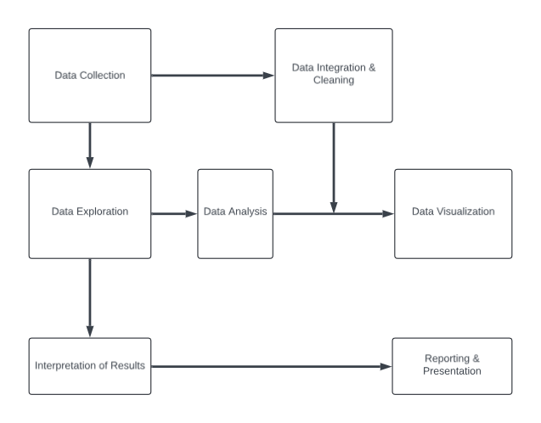
Task Abstraction (1)
Target:
The primary goal of the analysis using the COVID-19 dataset and World Development Indicators (WDI) dataset is to understand and visualize the impact of the COVID-19 pandemic across various countries, correlating it with different socio-economic and health indicators.
The analysis aims to identify trends, patterns, and outliers that can inform public health responses and policy-making.
Actions:
Data Integration and Cleaning:
Combine data from both datasets to align by country and date.
Clean the data by handling missing values, outliers, and errors.
Data Exploration:
Performed preliminary analysis to understand the structure and key characteristics of the data.
Identified initial patterns or inconsistencies that may require deeper investigation.

Slide 6
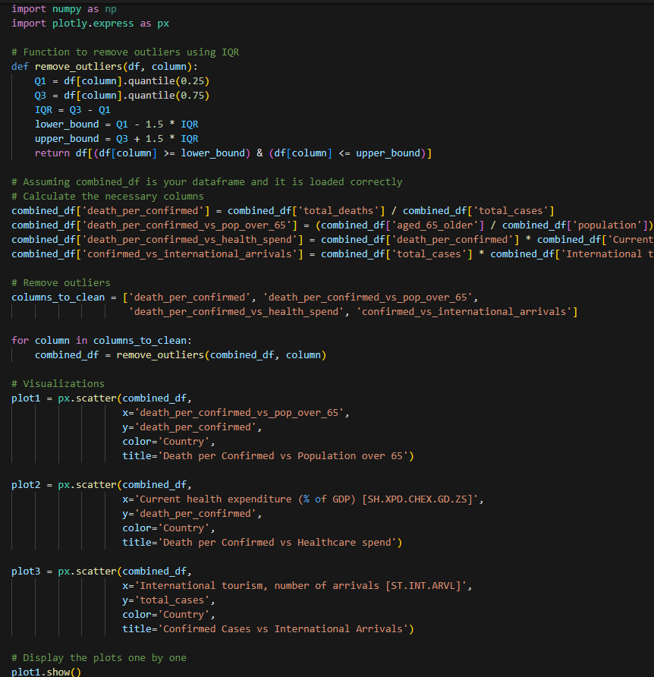
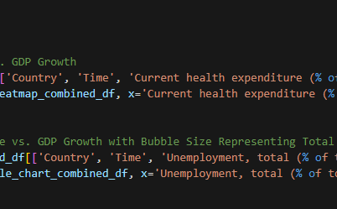
Task Abstraction (2)
Data Analysis:
Analyze COVID-19 trends such as total cases, deaths, and vaccination rates.
Correlate COVID-19 data with WDI indicators like GDP, health expenditure, and population density.
Visualization:
Develop interactive visualizations such as maps, heatmaps, and scatter plots to display COVID-19 metrics and their correlation with development indicators.
Utilize tools like D3.js for custom visualizations and Tableau for embedding comprehensive dashboards.
Interpretation:
Interpret the visual data to extract meaningful insights regarding the spread of the virus, effectiveness of health interventions, and the impact on different economies.
Identify patterns that could suggest strategies for future pandemic preparedness and response.
Reporting:
Prepare detailed reports and presentations outlining key findings, supported by data visualizations.
Provide recommendations based on the analysis to assist stakeholders in decision-making processes.

Slide 7
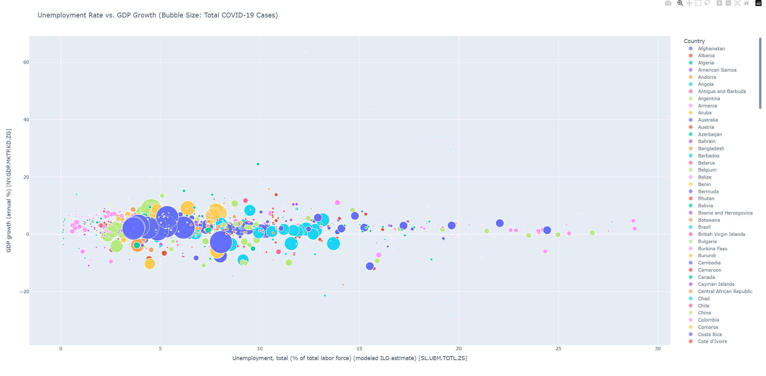
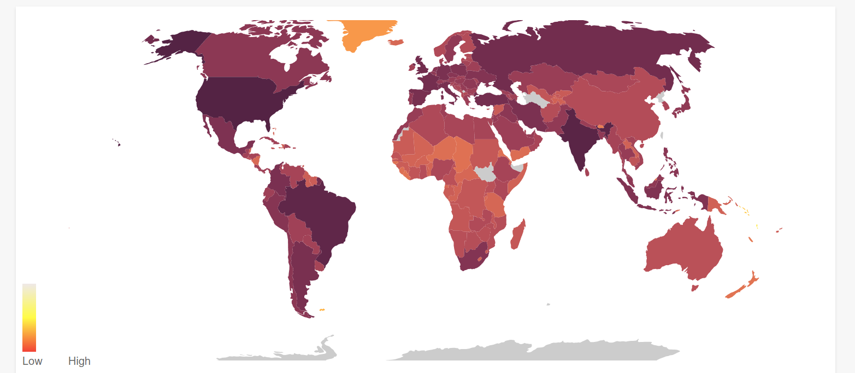
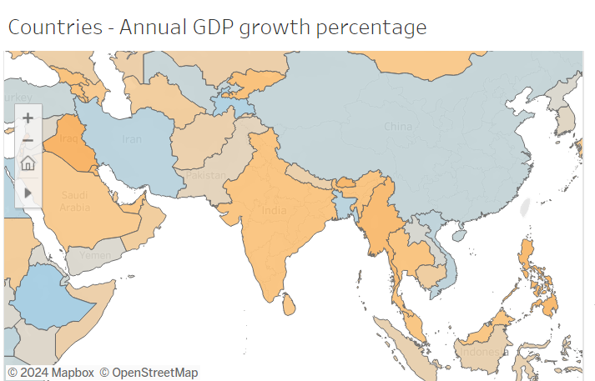
Implementation
Tools used for different visualizations:
D3.js:
To visualize the attributes such as total cases, total deaths, vaccinations etc, I have built a world map using d3.js. The JavaScript code (map.js) uses D3.js to draw a world map and color-code countries based on different metrics like total cases, deaths, ICU patients, etc. I have made the map visualization responsive to user interactions such as mouse hover and it provides additional information via tooltips.
Tableau:
I have used Tableau to create a dashboard to show the relation between different factors such as Covid 19 cases and deaths across countries and economic attributes such as GDP, stocks and unemployment
Python:
I have used Plotly library in python to create bubble charts and scatter plots to show the relation between factors such as unemployment, GDP etc

Slide 8
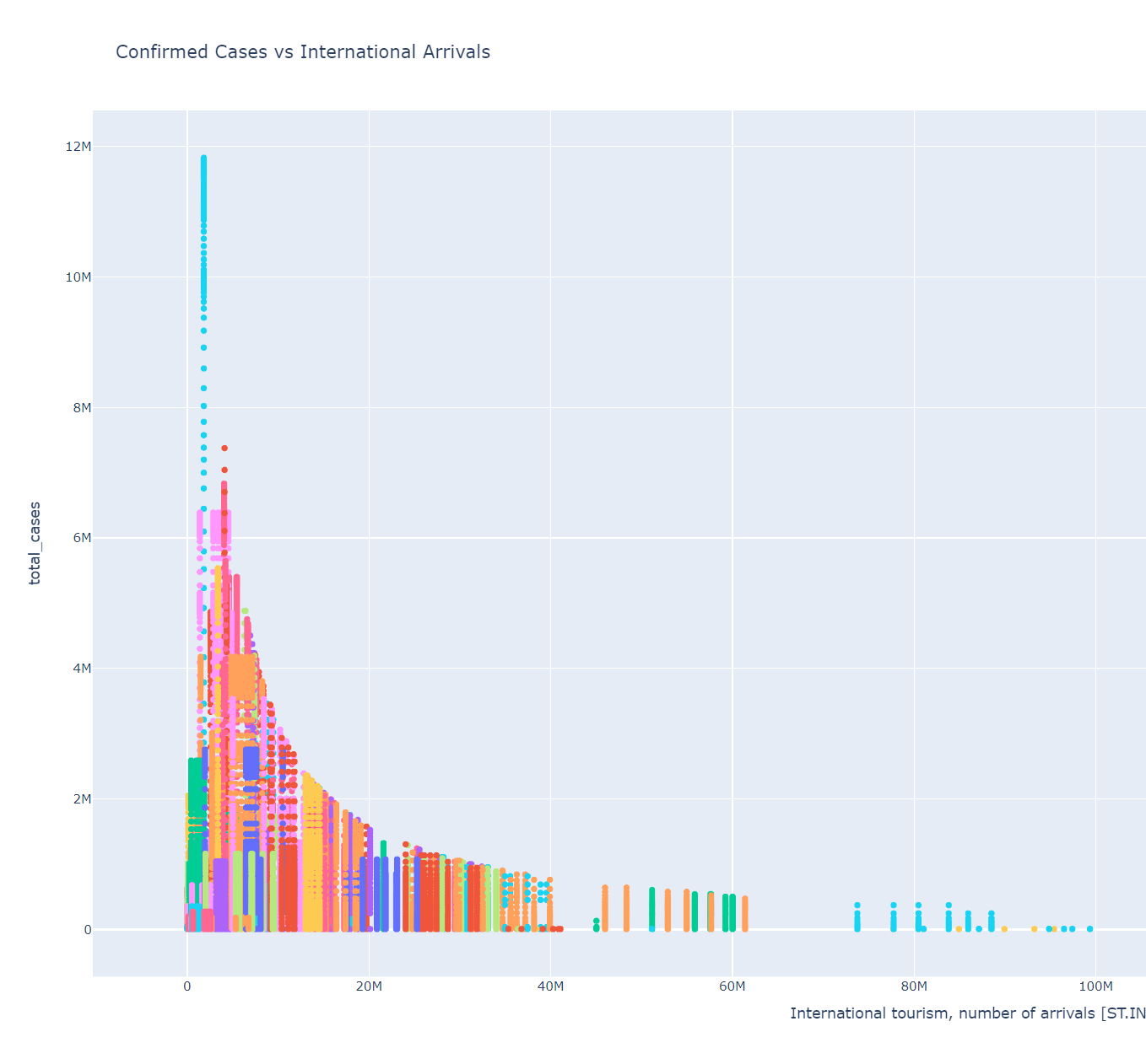
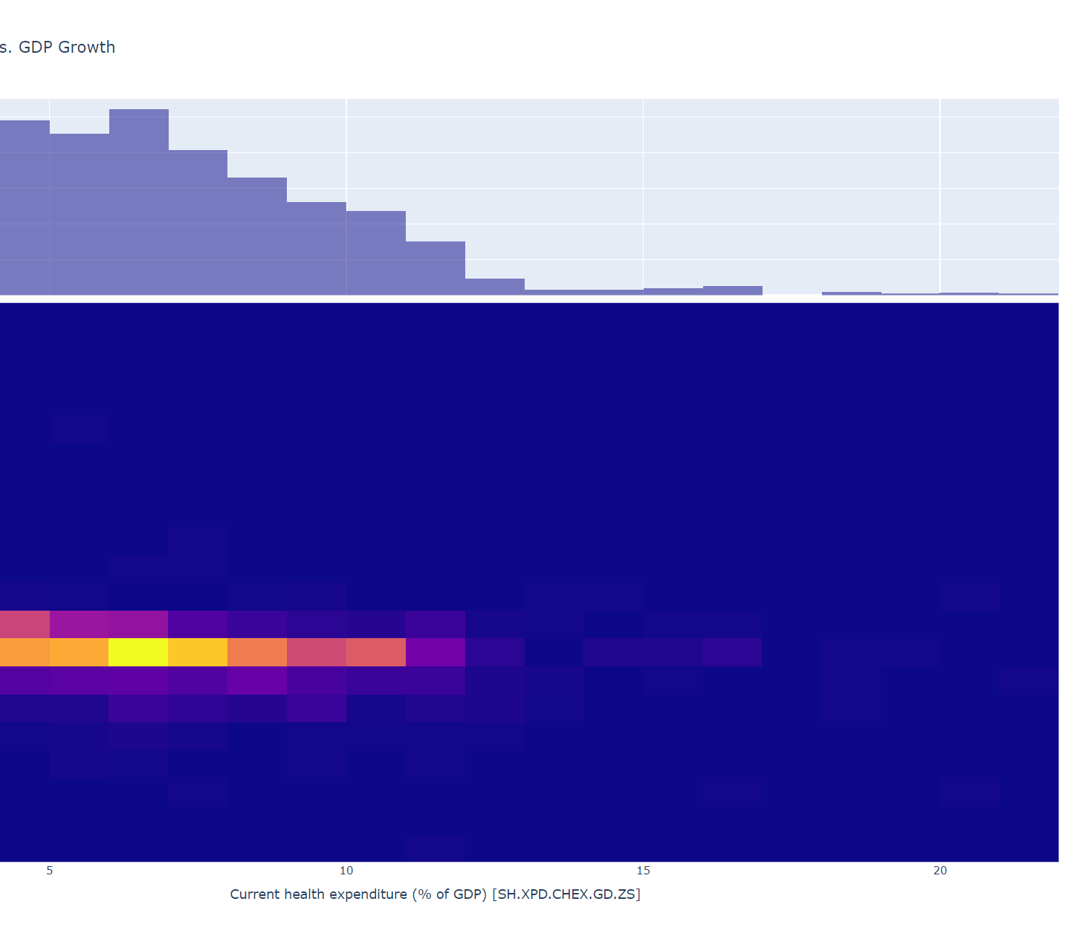
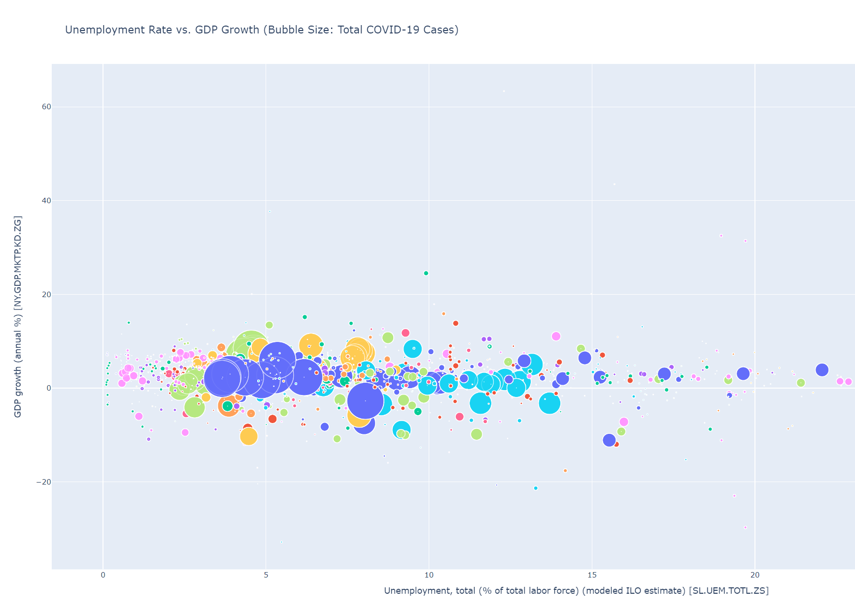
Python Plots
Visualization 1: Unemployment Rate vs. GDP Growth (Bubble Size: Total COVID-19 Cases)
The scatter plot visualizes the relationship between the unemployment rate and GDP growth of various countries, with the bubble size representing the total number of COVID-19 cases in each country.
Visualization 2: Health Expenditure vs. GDP Growth
The heatmap visualizes the correlation between health expenditure and GDP growth. The color density represents the count of data points that fall within a specific range on the plot.
Visualization 3: Confirmed Cases vs. International Arrivals
The bar chart visualizes the relationship between the number of confirmed COVID-19 cases and international tourist arrivals in each country.

Slide 9
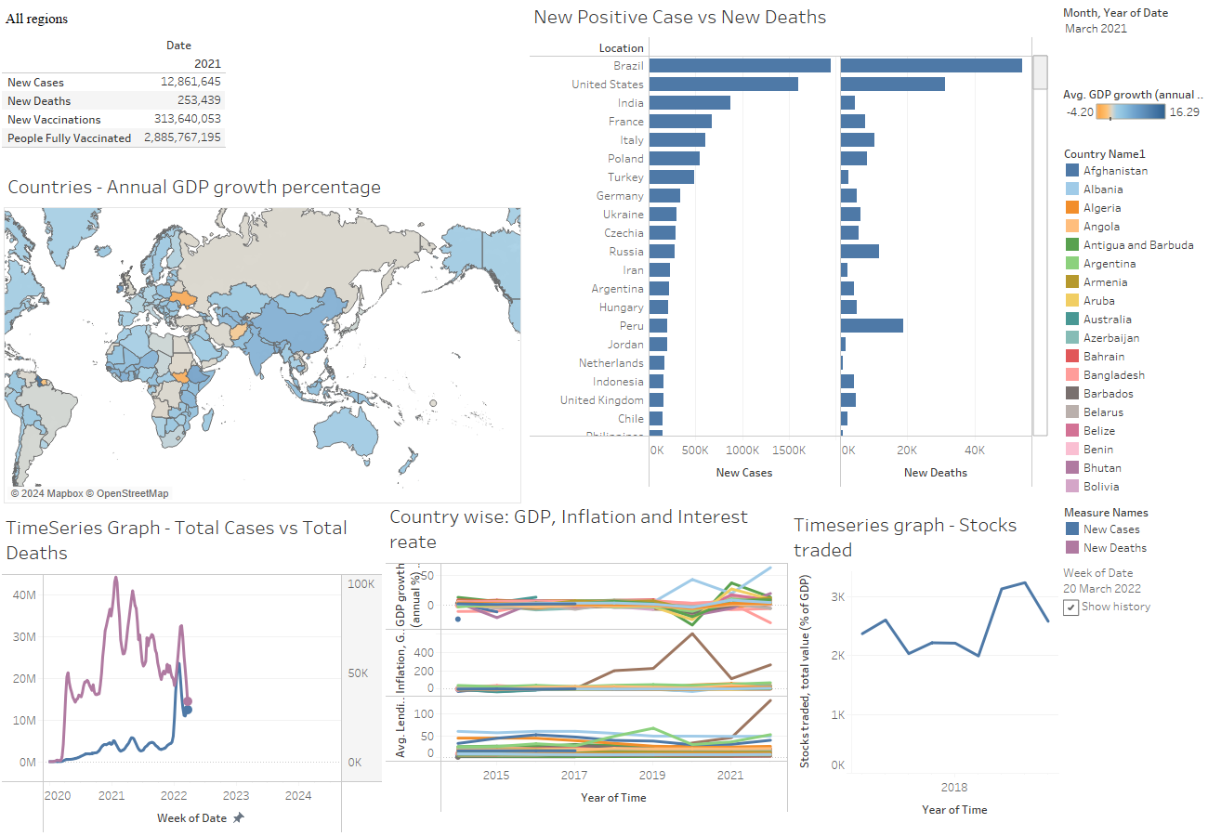
Tableau Plots (1)
The dashboard is made up of 6 plots:
Key statistics pannel
This section provides a snapshot of the global impact of COVID-19 for a specified date, including New Cases and Deaths and Vaccination Data
Map of Annual GDP Growth Percentage
This choropleth map displays the annual GDP growth percentage for countries around the world, color-coded for quick visual interpretation.
Bar Chart of New Positive Cases vs. New Deaths
This bar chart offers a comparison between new COVID-19 cases and new deaths for selected countries

Slide 10
Tableau Plots (2)
Time Series Graph - Total Cases vs. Total Deaths
This line graph shows the trend over time for total COVID-19 cases and deaths.
Multivariate Time Series Chart - Country Wise: GDP, Inflation, and Interest Rate
This chart compares multiple economic indicators across different countries over time, with each line representing a country.
Time Series Graph - Stocks Traded
The final graph shows the value of stocks traded over time as a percentage of GDP, which is an indicator of the stock market’s performance and investor sentiment.

Slide 11
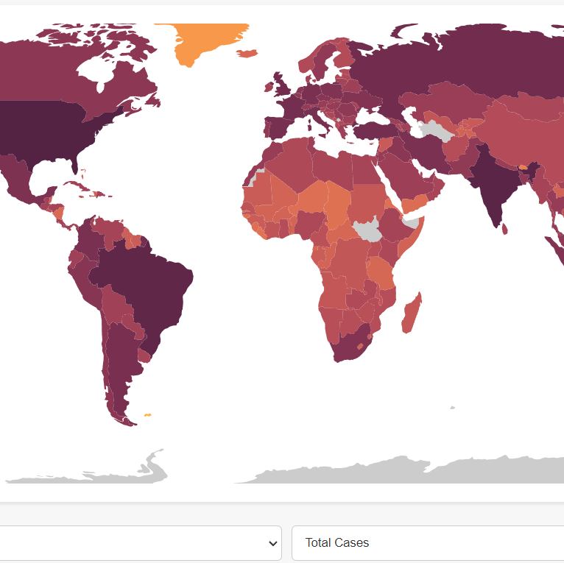
D3.js Plot
Choropleth map:
The world map provides different factors pertaining to Covid 19 such as total cases, deaths, vaccines etc across countries. The Drop-down menus give us options to chose the attribute we want to explore and the year in which we want to explore it.
The map uses a color gradient from yellow (low) to dark red (high) to signify the intensity of cases in each country. Darker regions highlight areas with higher case counts, revealing the pandemic's hotspots and providing a stark visual representation of the disparities in case distribution.

Slide 12
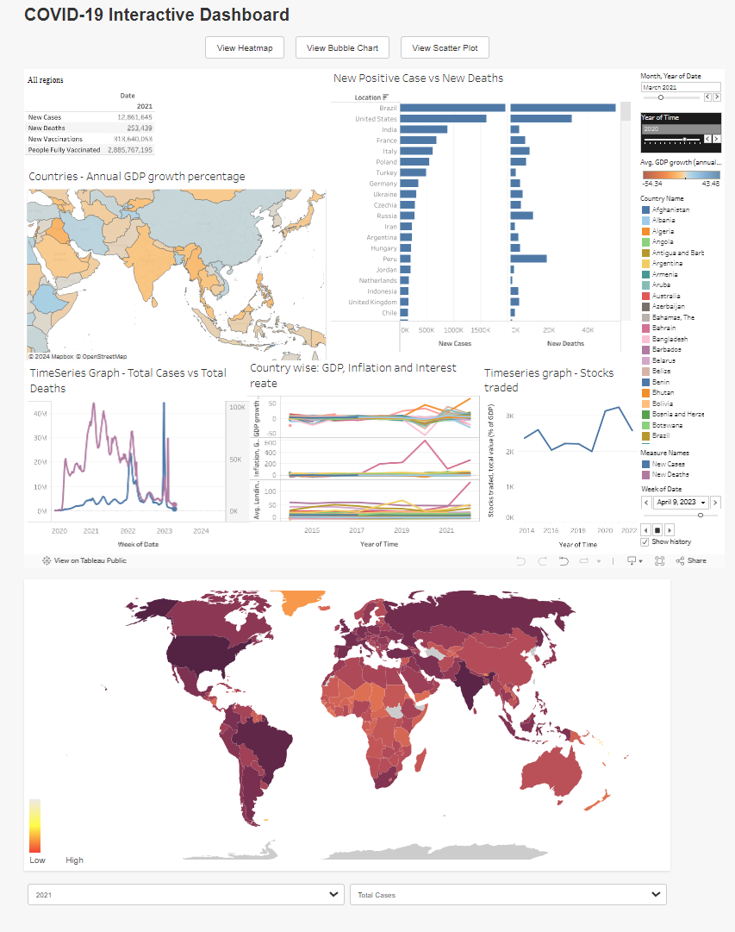
Work Management
As I am the only person in my group, I have worked on all the tasks alone.
Website Link
https://uthkarshh.github.io/Scientific-Data-Visualization-Project/

Slide 13
References/Bibliography
World Health Organization. (2023). COVID-19 Data Dashboard. Retrieved from https://covid19.who.int/
World Bank. (2022). Global Economic Prospects, June 2022. Retrieved from https://www.worldbank.org/en/publication/global-economic-prospects
International Monetary Fund. (2021). World Economic Outlook, April 2021: Managing Divergent Recoveries. Retrieved from https://www.imf.org/en/Publications/WEO/issues/2021/03/23/world-economic-outlook-april-2021
United Nations. (2020). Policy Brief: Education during COVID-19 and Beyond. Retrieved from https://www.un.org/development/desa/dspd/wp-content/uploads/sites/22/2020/08/sg_policy_brief_covid-19_and_education_august_2020.pdf

Slide 14

Thank you

